Slide 1


Slide 2


Annual Dinner Committee
^{Patricia A. Murphy}
^{Toni Agovino}
^{Gail Fishkind}
^{Raymond Ferrigno}
^{Anne Gordon}
^{Laura J. Kennedy}
^{Meri Krassner}
^{Nancy Petrino}
^{I. William Stone}
^{Angelo Aponte}
^{Chairperson}
^{Committee Member}
^{Committee Member}
^{Committee Member}
^{Committee Member}
^{Committee Member}
^{Committee Member}
^{Committee Member}
^{Committee Member}
^{President}

Slide 3

AHRC New York City
A Chapter of the Arc New York
Officers
^{Angelo Aponte, President}
Edward J. Leahy, 1st Vice President
Sharyn Van Reepinghen, 2nd Vice President
^{Patricia A.} ^{Murphy, 3rd Vice President}
Raymond Ferrigno, 4th Vice President
^{Tina Veale, 5th Vice President}
^{Victoria Liska, Treasurer}
Andreas Chrysostomou, Financial Secretary
Marilyn Jaffe Ruiz, Recording Corresponding Secretary
Board of Directors
^{Toni Agovino}
^{Mark Bini}
^{Stephen Brodsky}
^{Kathleen Cervasio}
^{Marie Lourdes Charles}
^{Gail Fishkind}
^{Melvin Gertner}
^{Anne Gordon}
^{Cory O. Henkel}
^{Laura J. Kennedy}
^{Meri Krassner}
^{Anthony Lazanas}
Executive Staff
^{Marco R. Damiani, Chief} ^{Executive Officer}
Amy West, Chief Financial Officer
Kathy Broderick, Acting Chief Operating Officer
Alden Kaplan, Senior Policy Advisor
Ann Greenberg, Founder (Deceased)
^{Evander Lomke}
^{Edith Niedert}
^{Genevieve O’Neil}
^{Nancy Petrino}
^{Ruth Pickholz}
^{Michael N. Rosen}
^{Simran Kaur Sachdev}
^{Nilsa Santiago}
^{Germaine Laviscount Scott}
^{Jeanne Sdroulas}
^{I. William Stone}
^{Kerry Wright}

Slide 4

CAPITAL HEALTH CONSULTING
KONICA MINOLTA
DUFF & PHELPS
and
for printing our Dinner Journal Pro-Bono
MEDLINE
and
for their Platinum Sponsorships
PITTA BISHOP &
DEL GIORNO LLC
for their Gold Sponsorships
Thank you to our sponsors!

Slide 5

CONGRATULATIONS TO OUR HONOREES
KONICA MINOLTA, RICK PIRROTTA
AHRC NYC’s Corporate Leadership Award
JOSHUA HIRSCH
AHRC NYC’s Anne Kraus Award
DALE HENSLEY
AHRC NYC’s Humanitarian Award

Slide 6

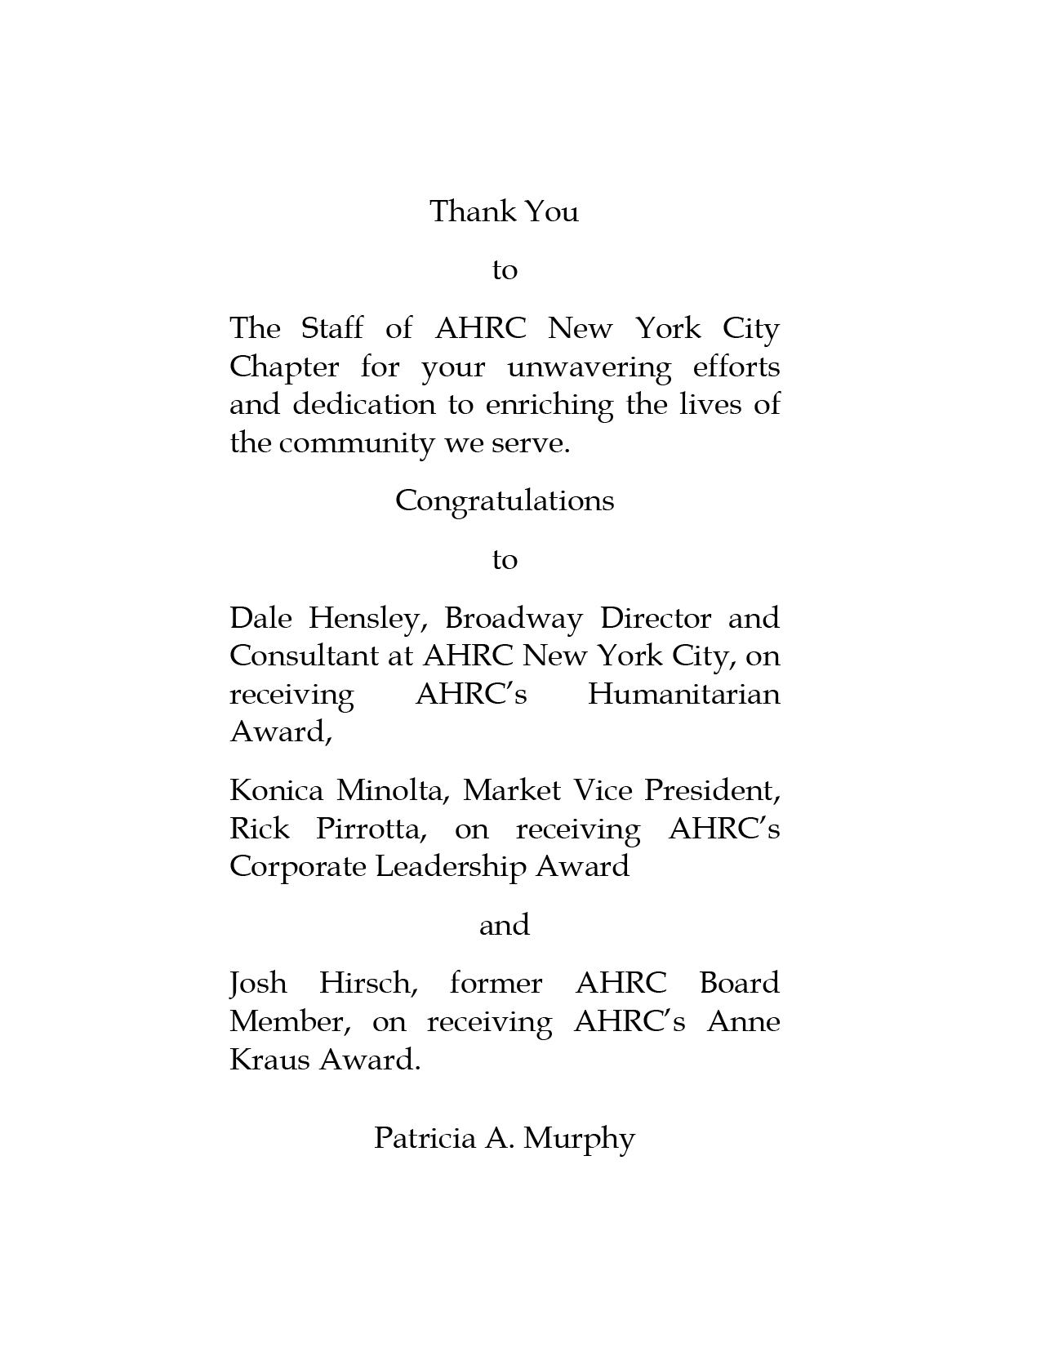







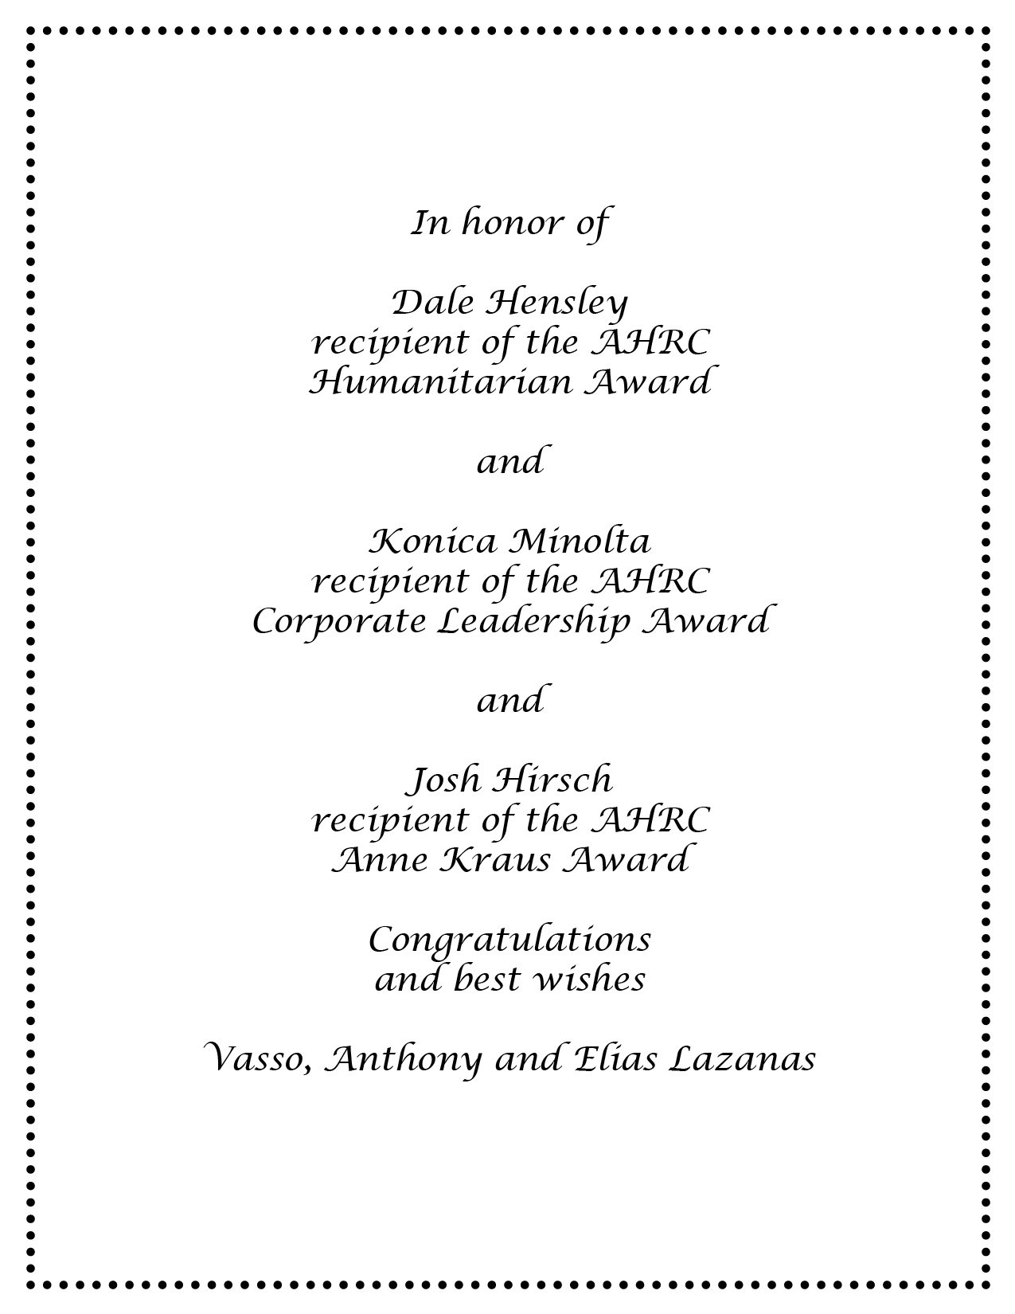
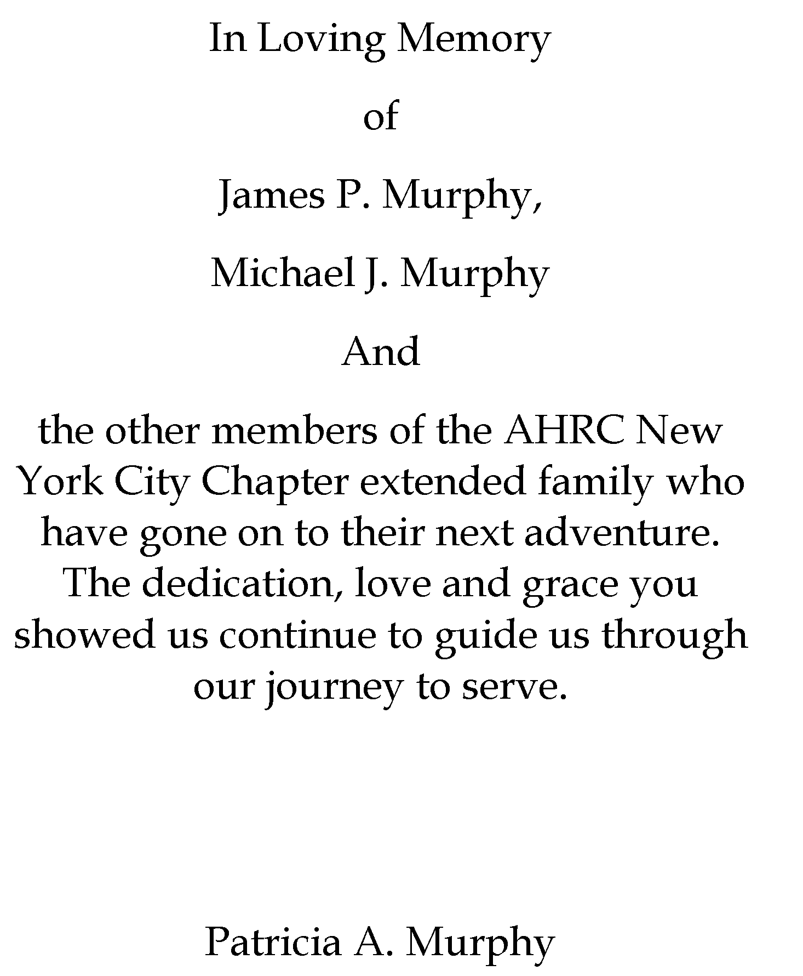

Special
Thanks
To Our
Platinum
Level
Supporters

Slide 7
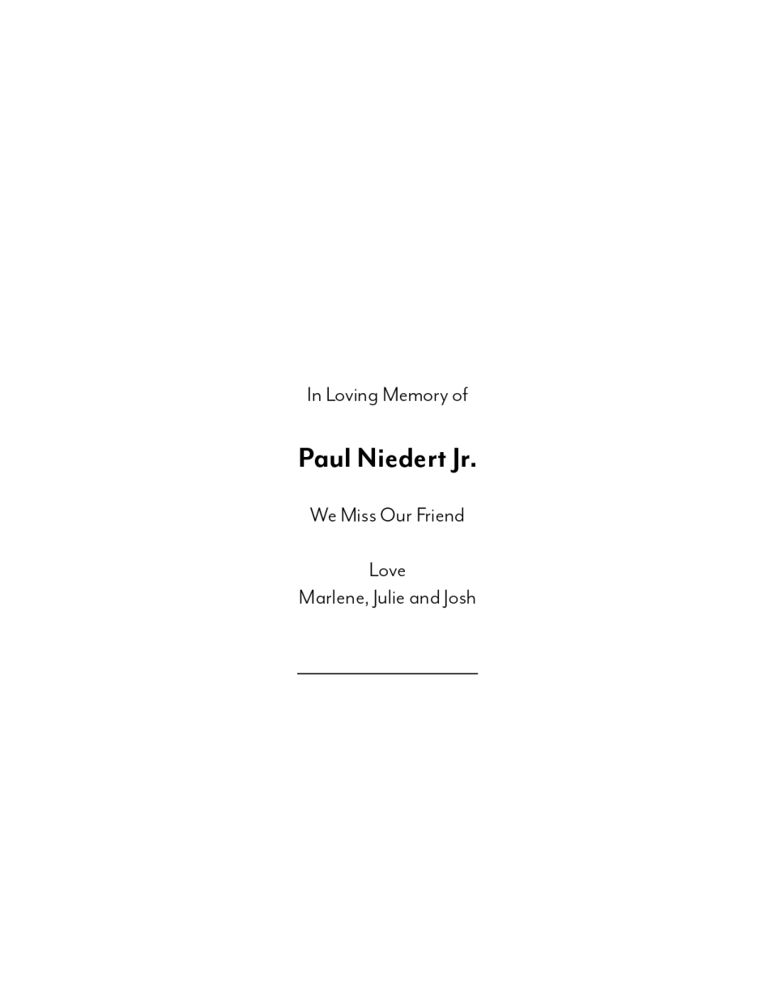

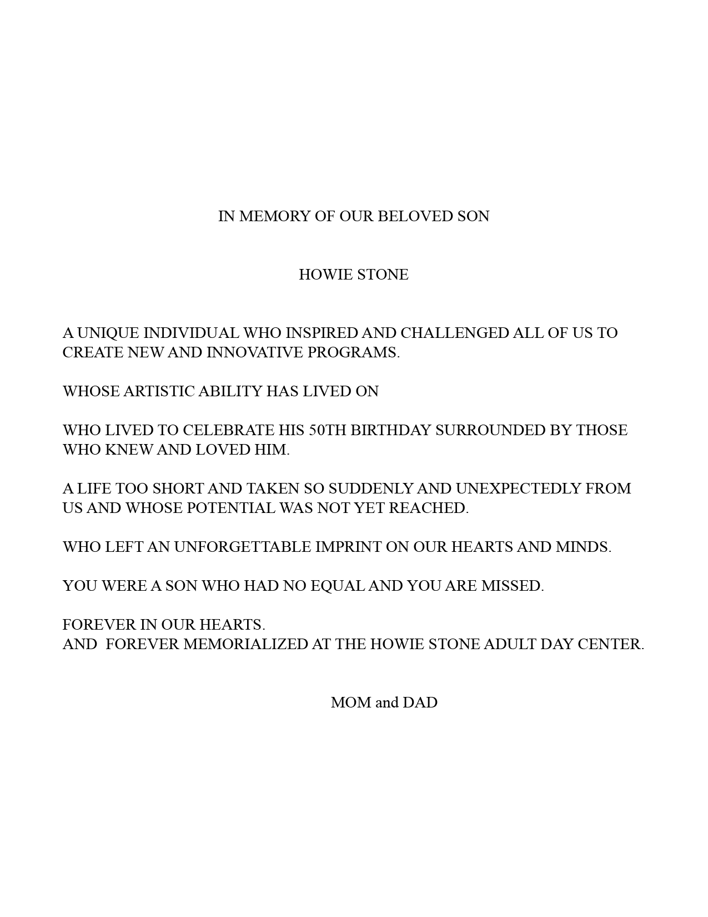

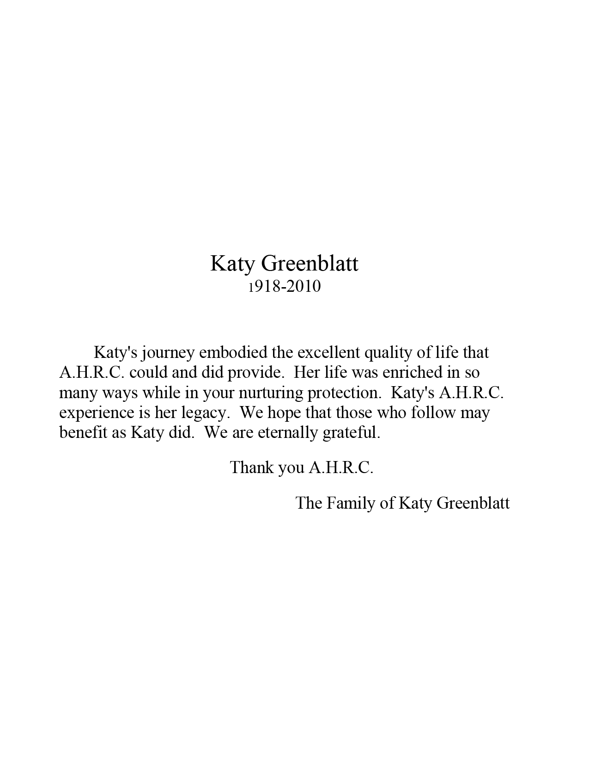

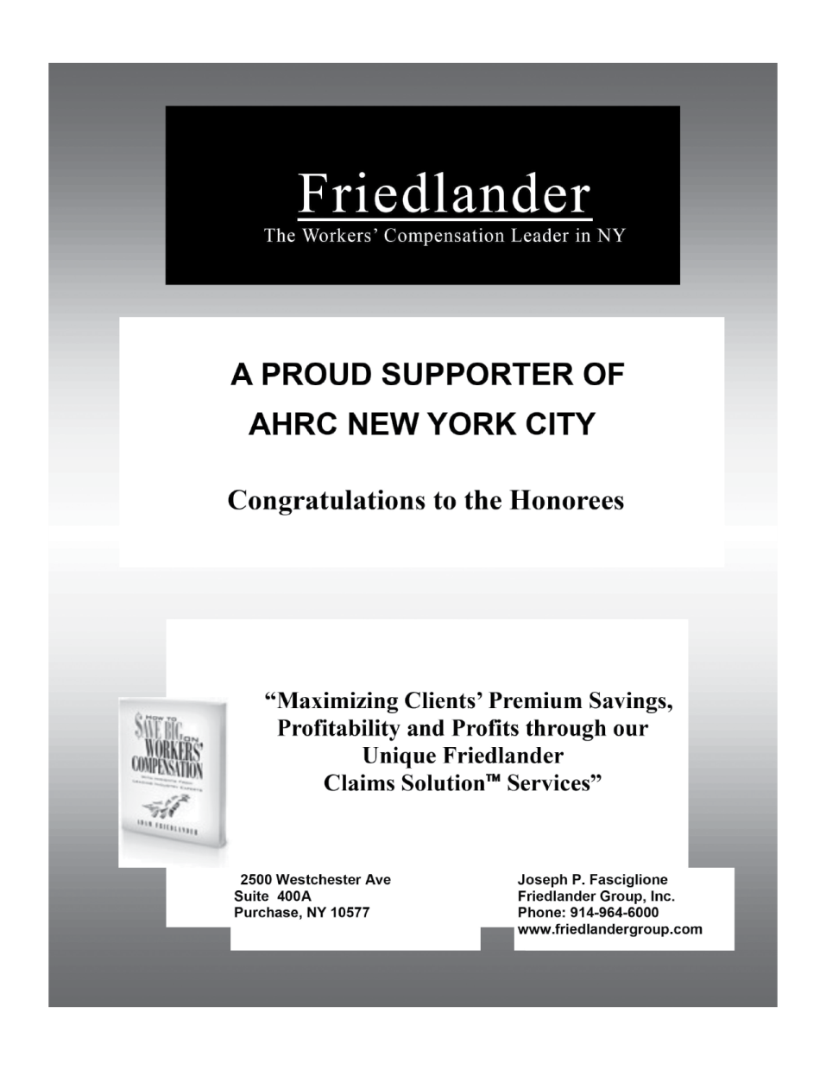


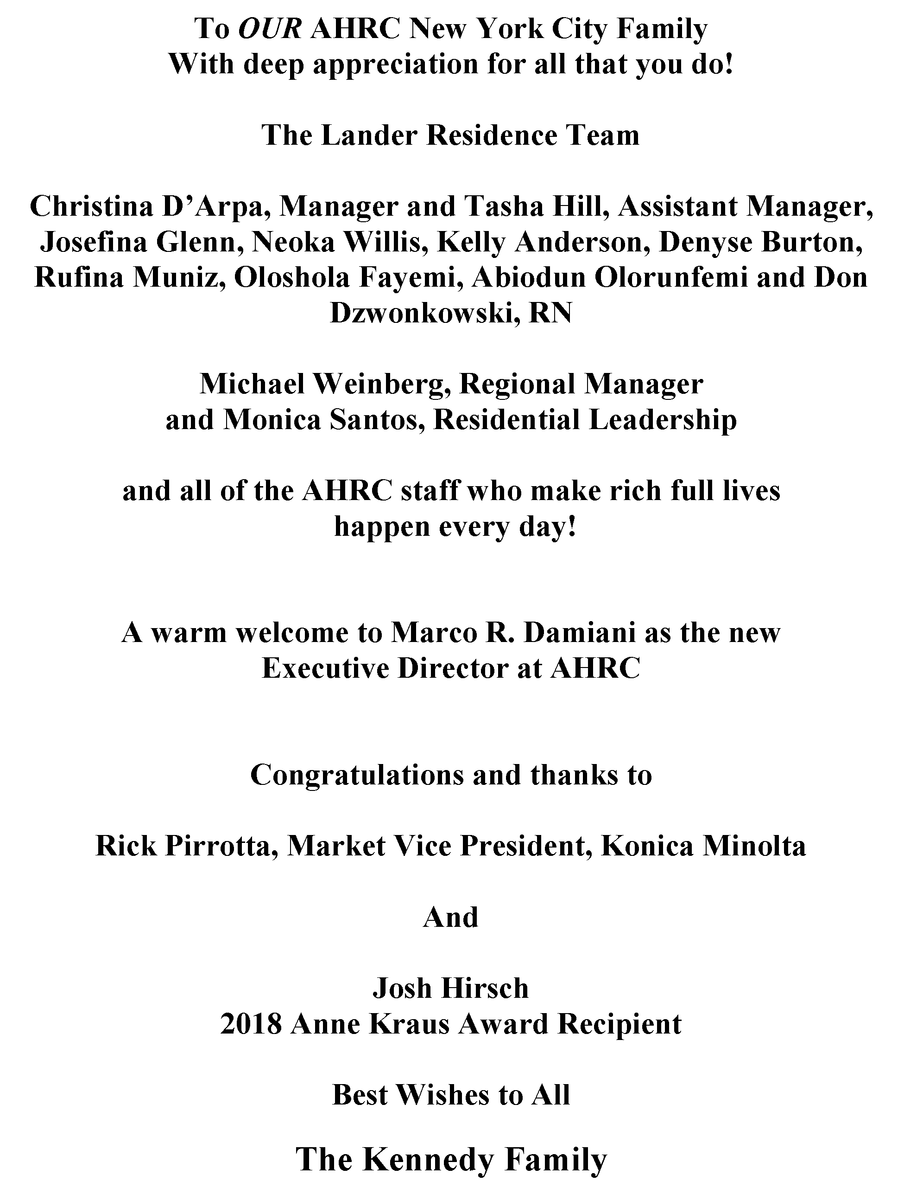
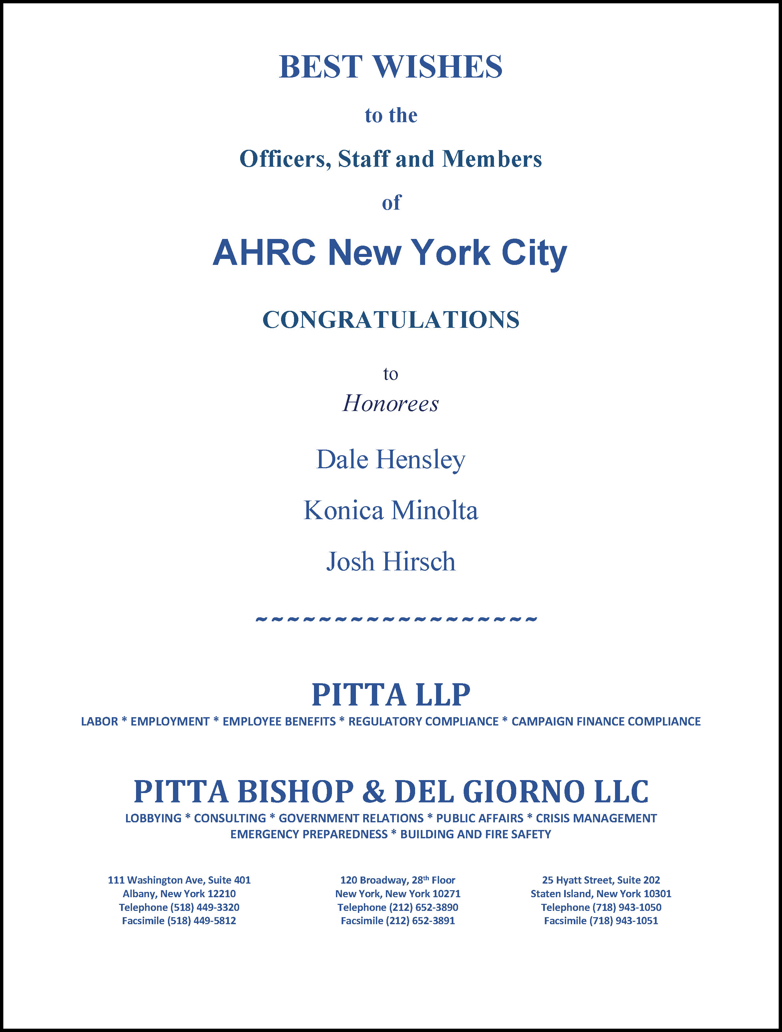




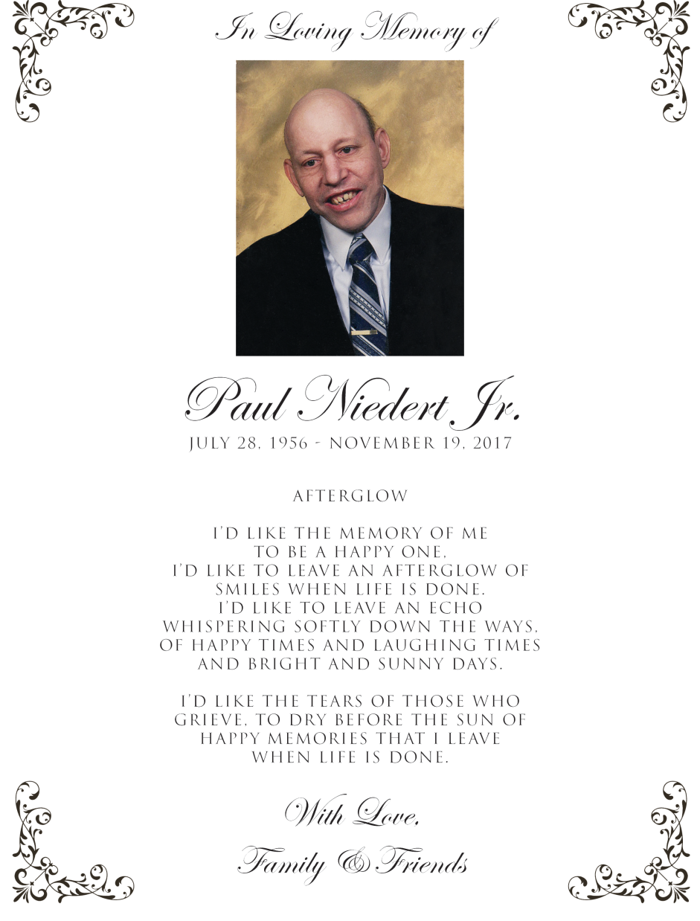
Special
Thanks
To Our
Gold
Level
Supporters

Slide 8
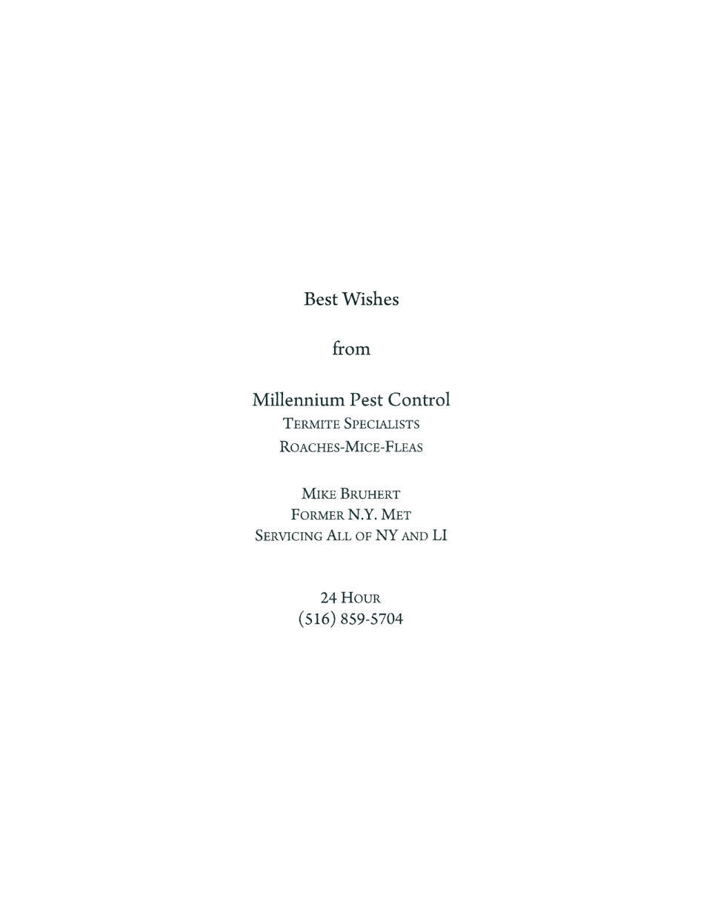








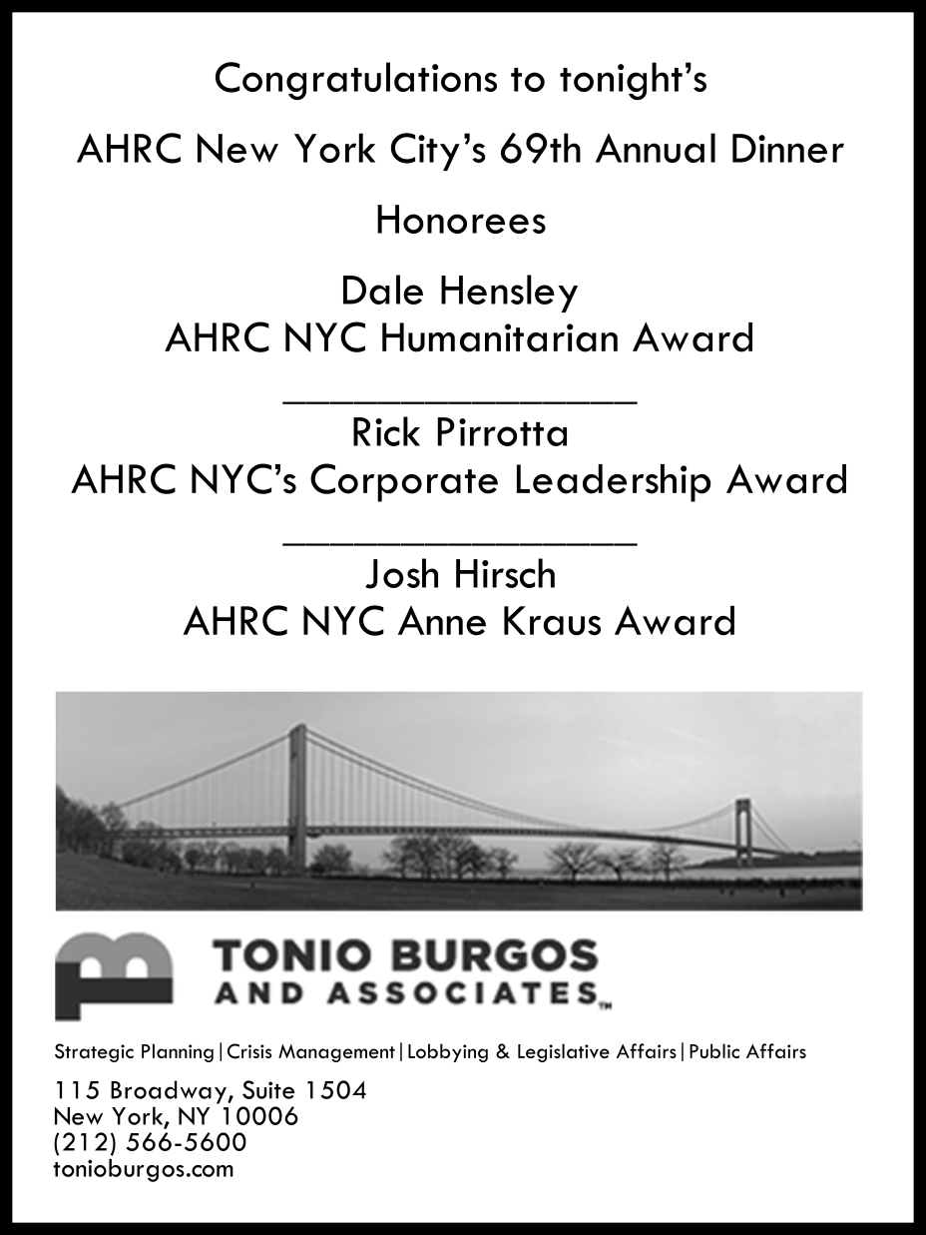


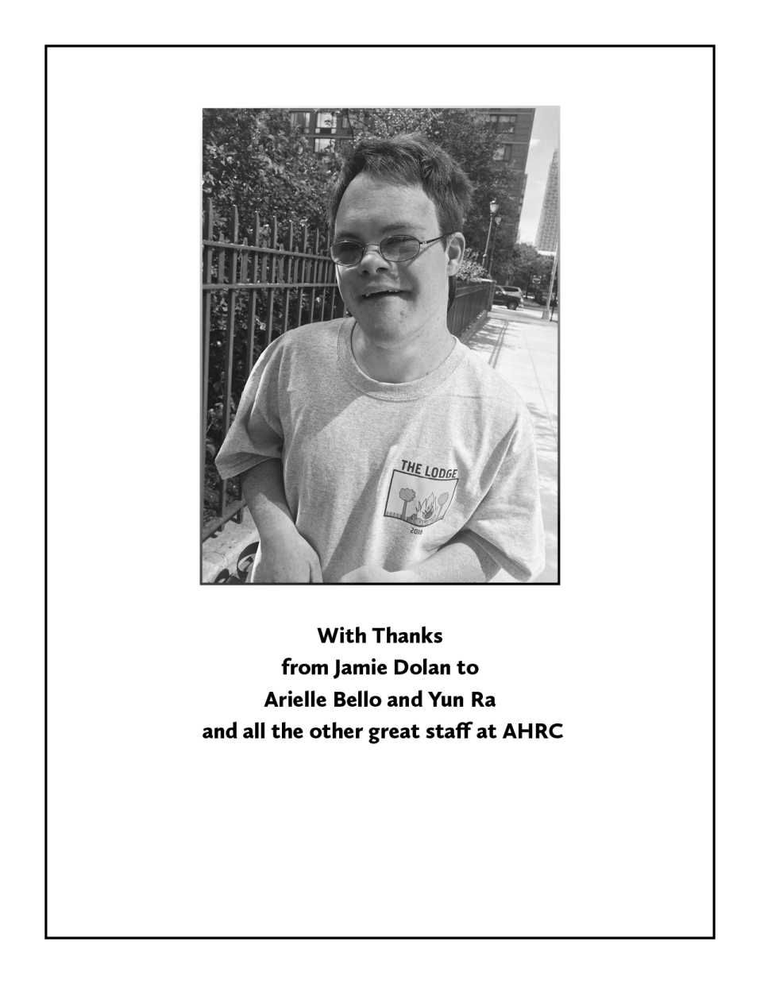


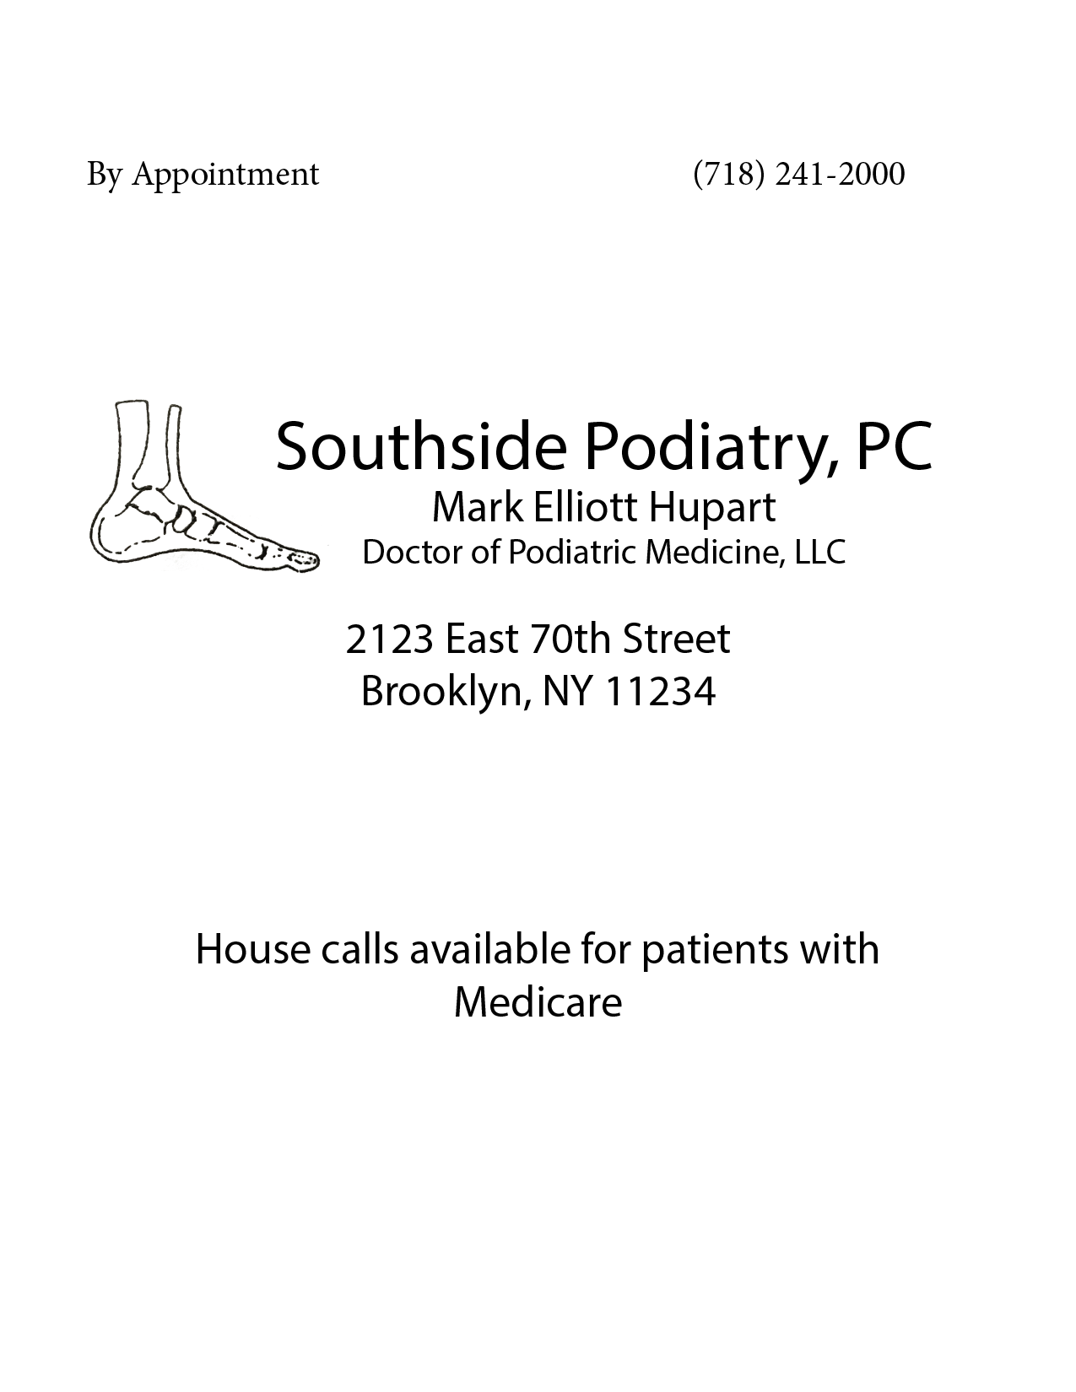
Special
Thanks
To Our
Silver
Level
Supporters

Slide 9
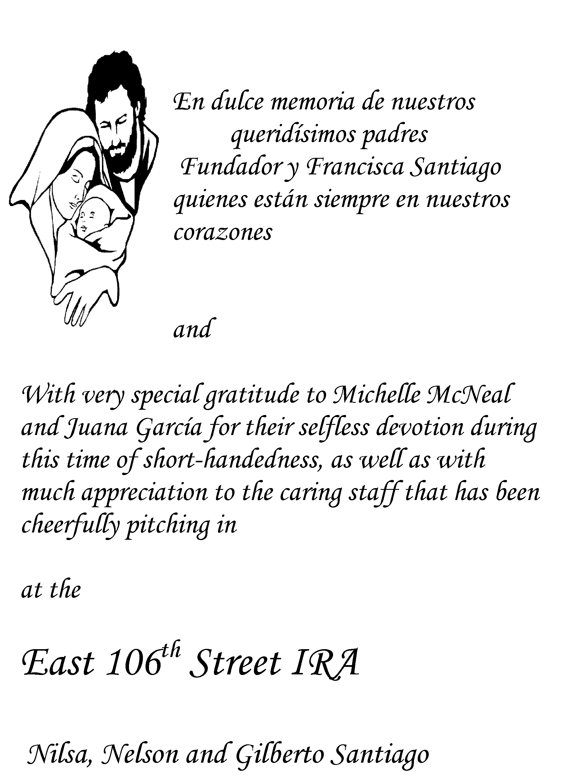

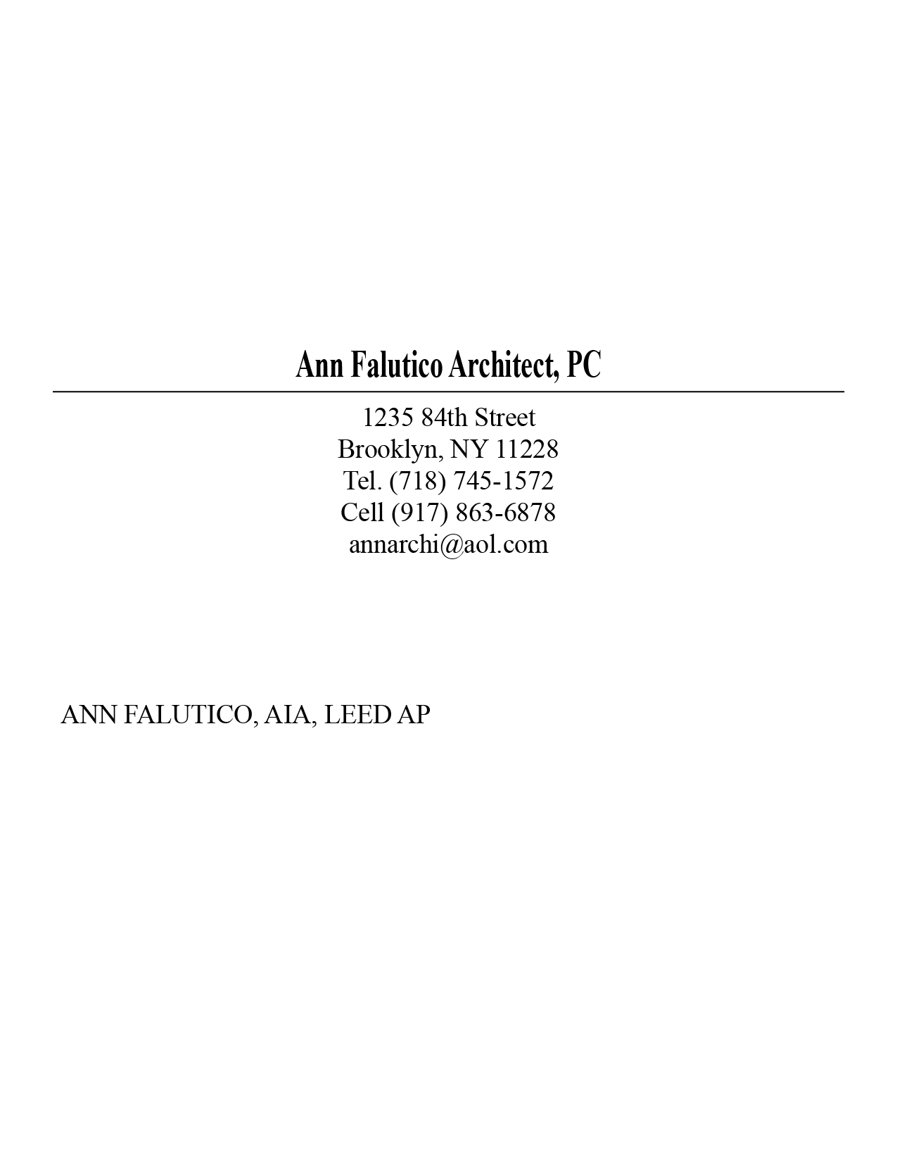


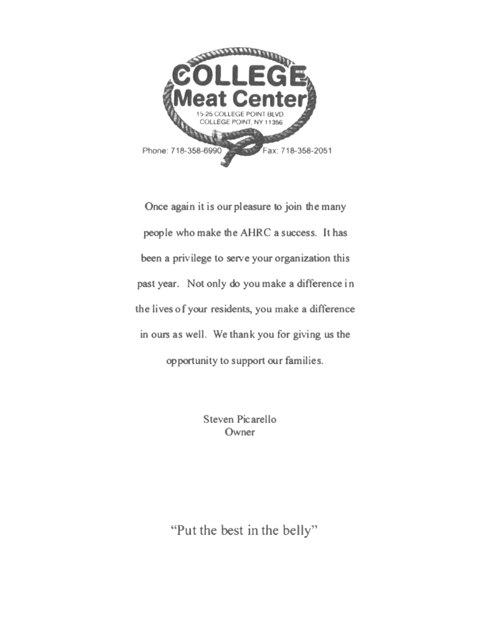



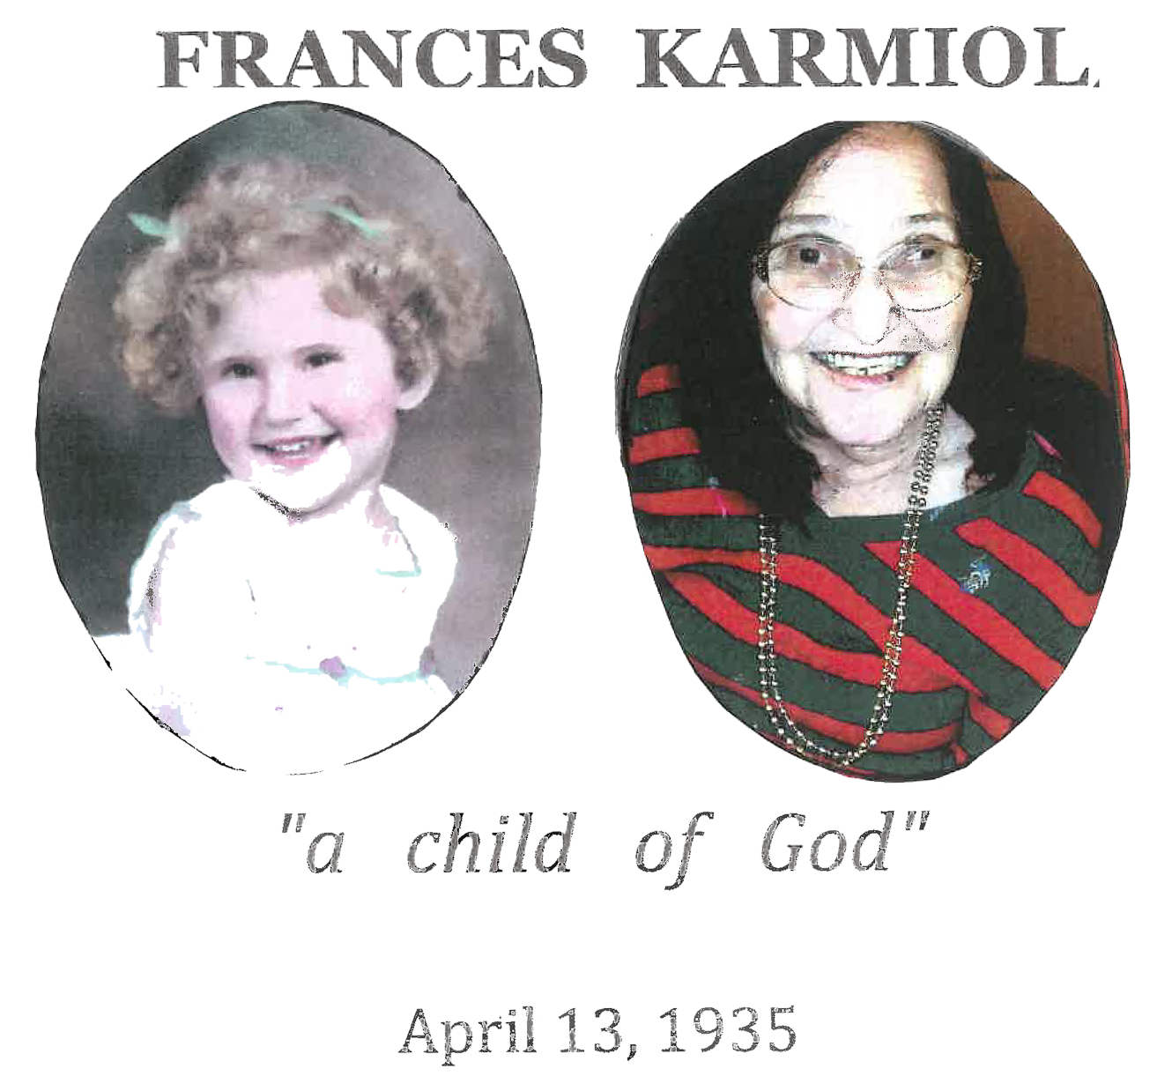

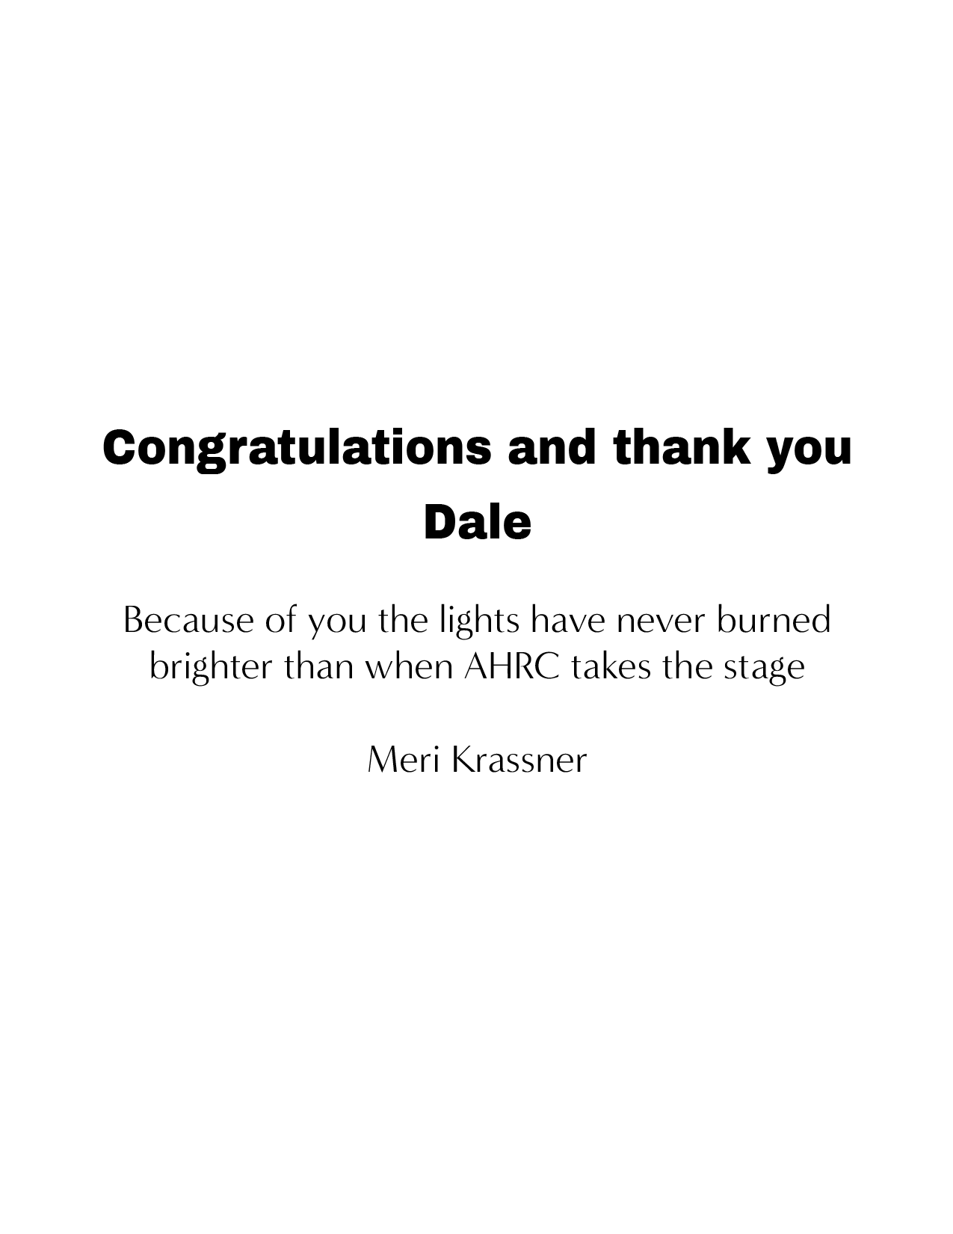





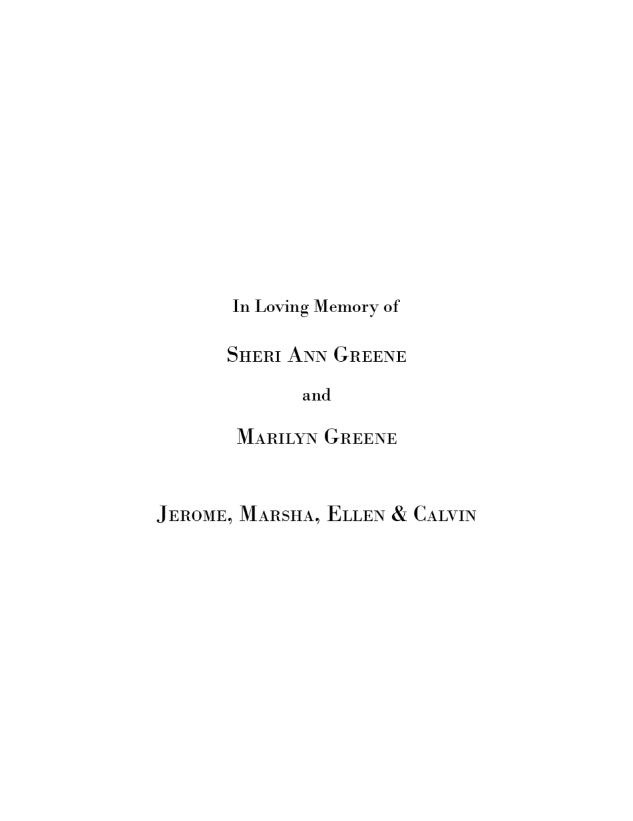
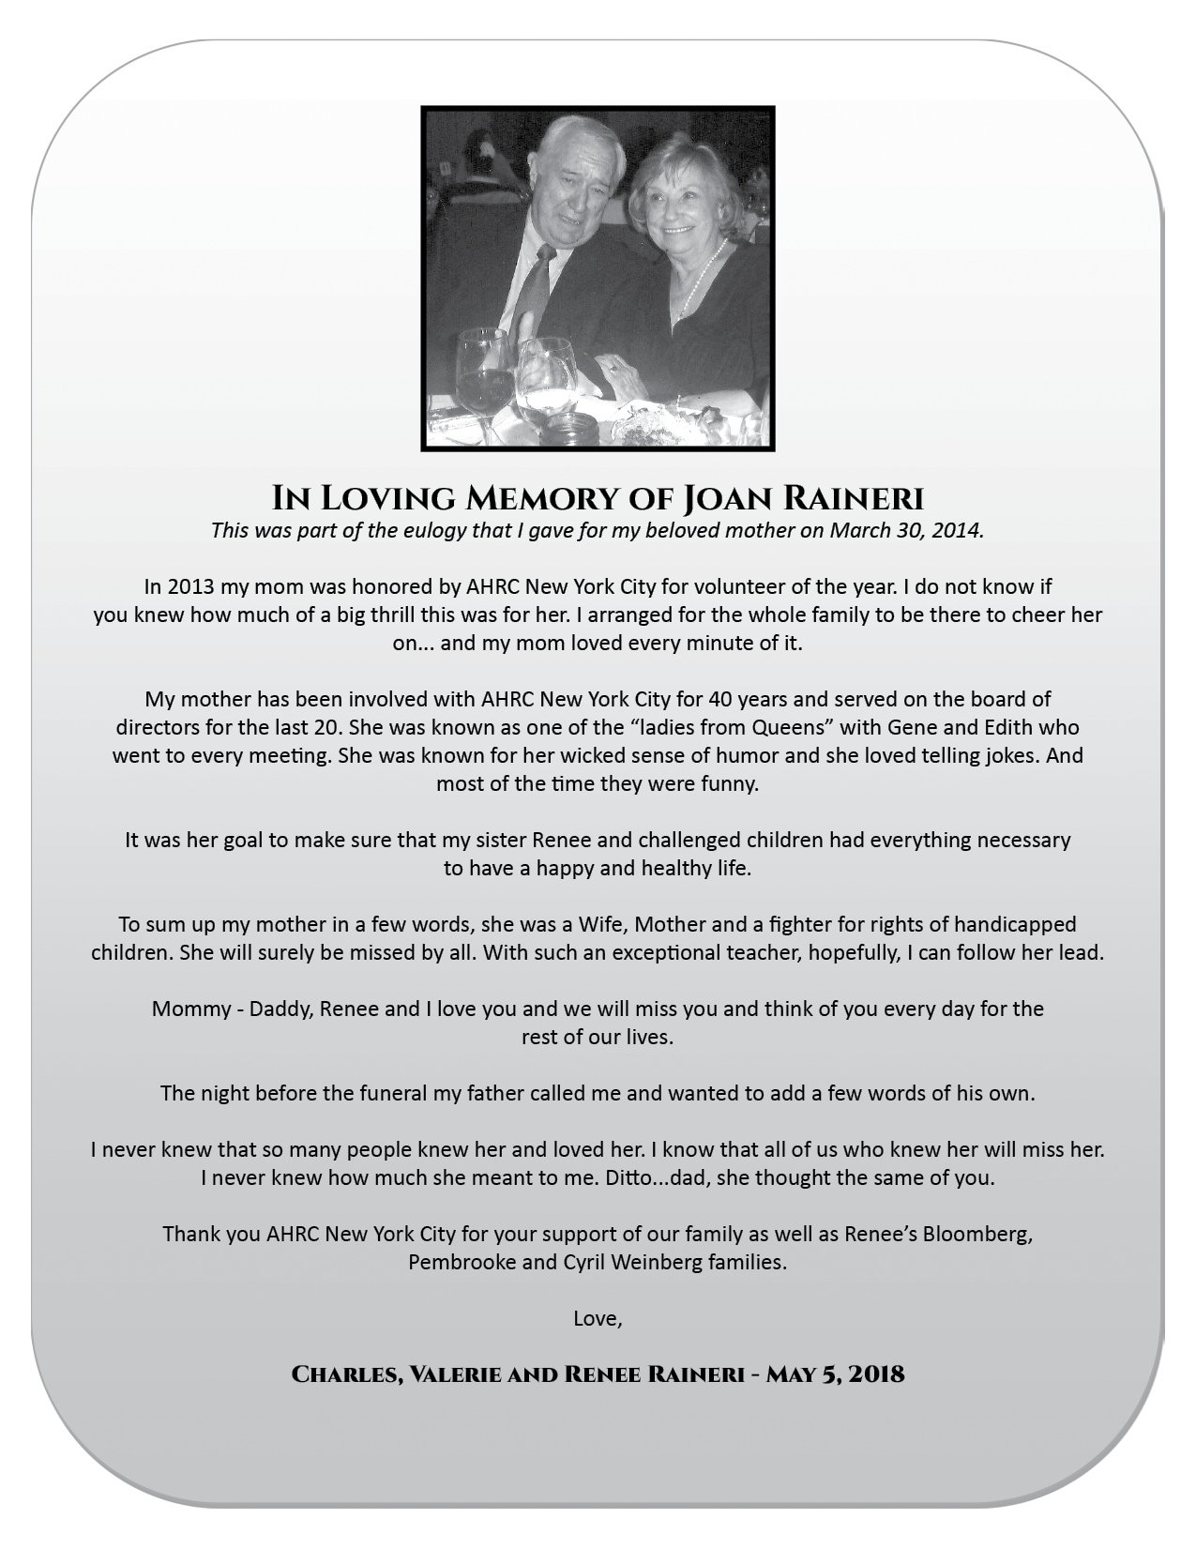





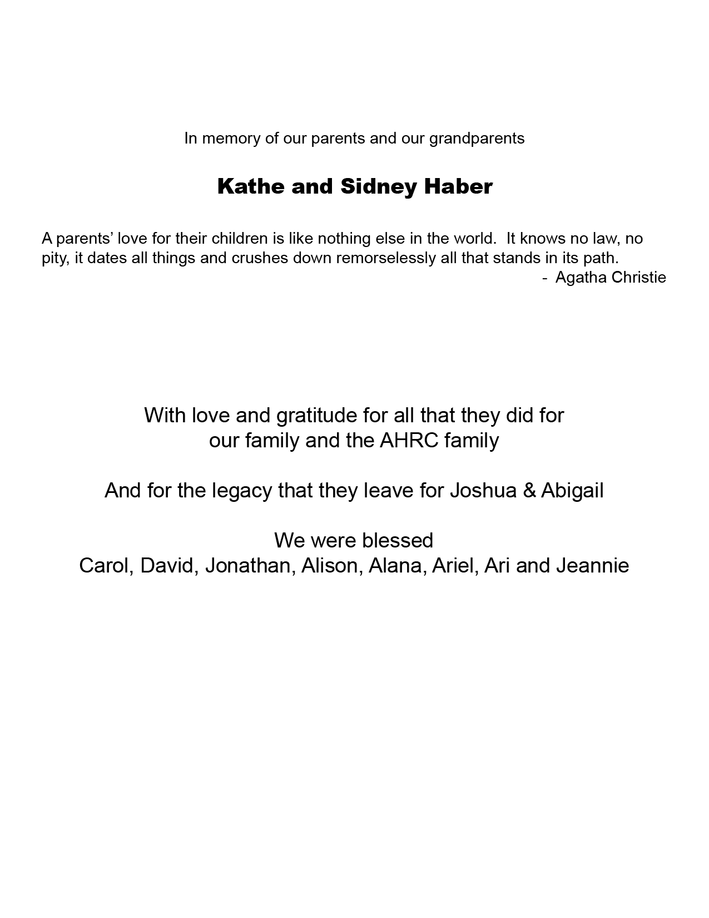



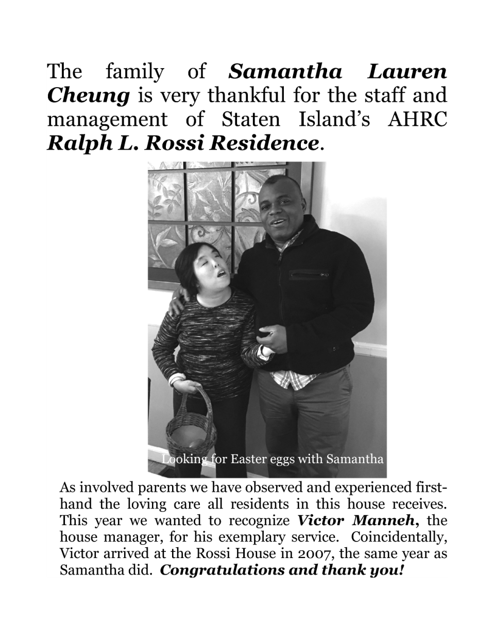

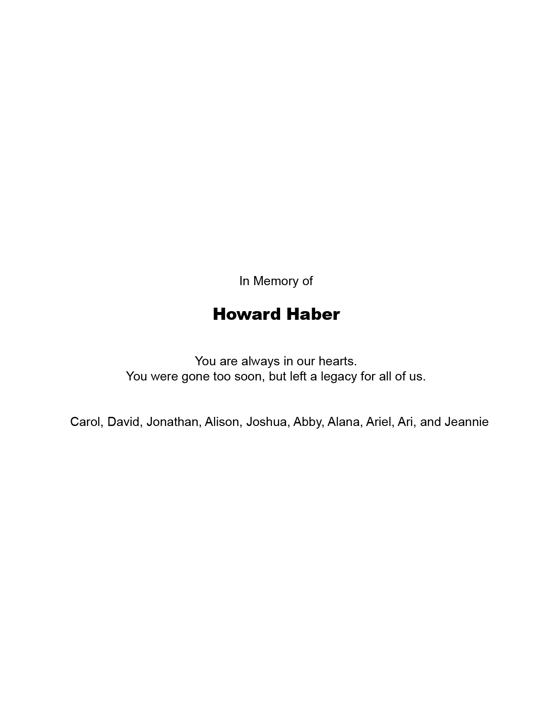

Special
Thanks
To Our
White
Level
Supporters

Slide 10
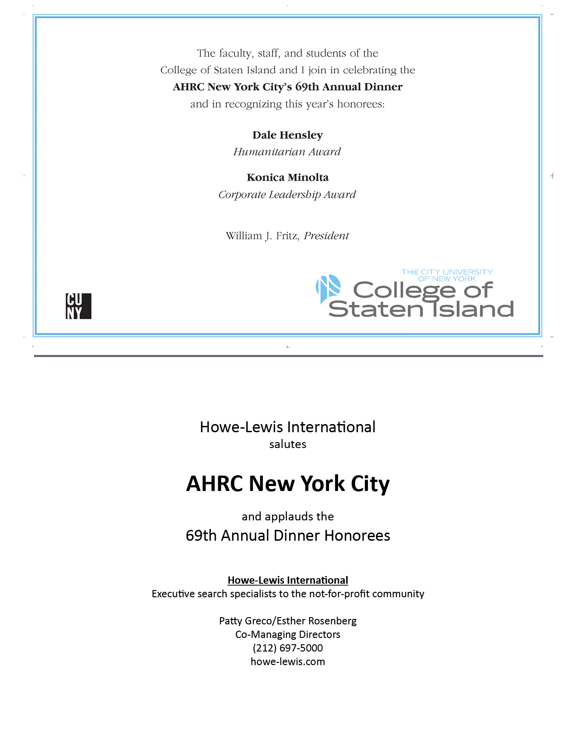
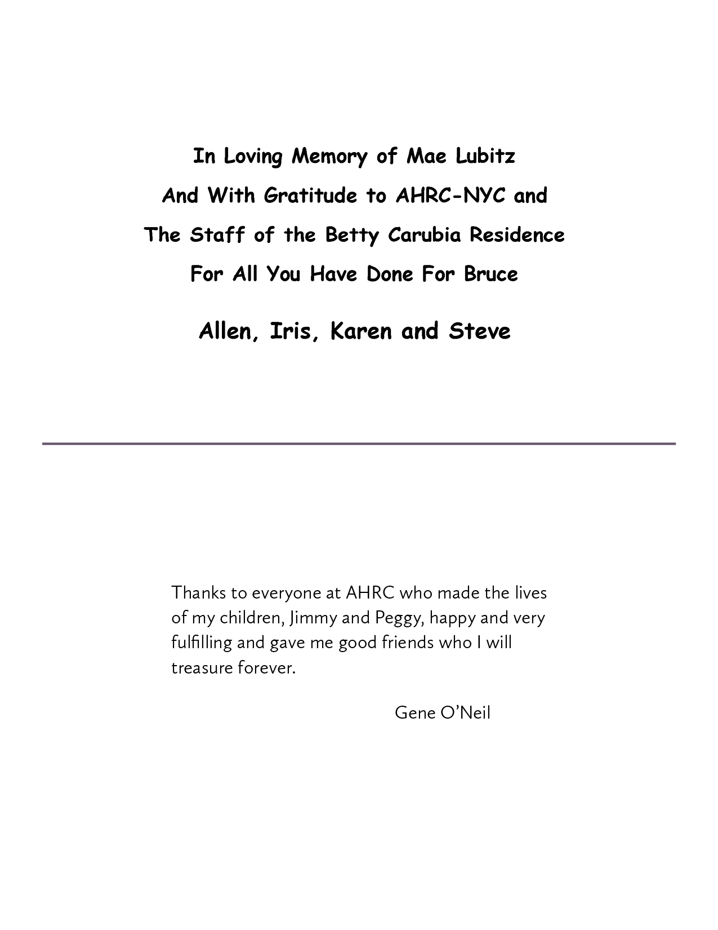

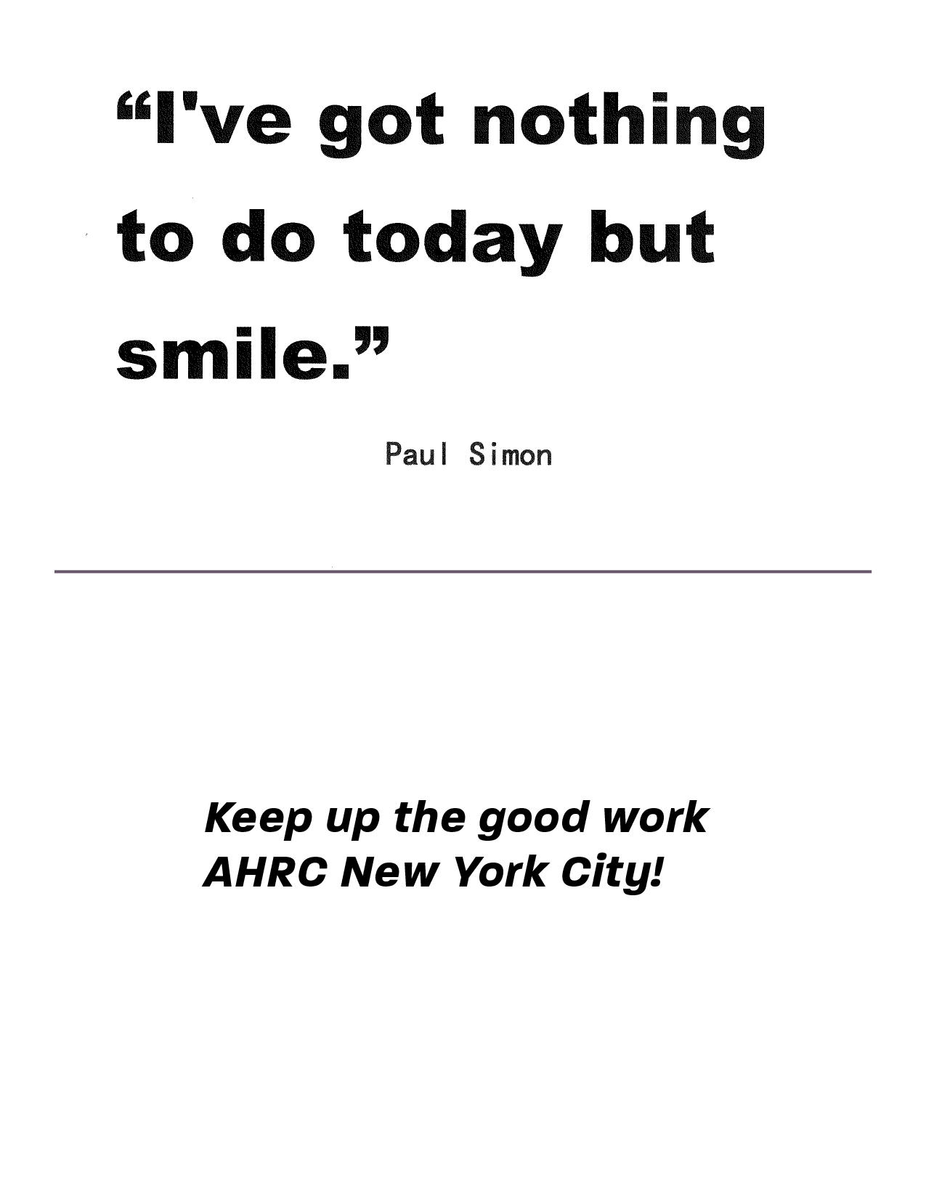

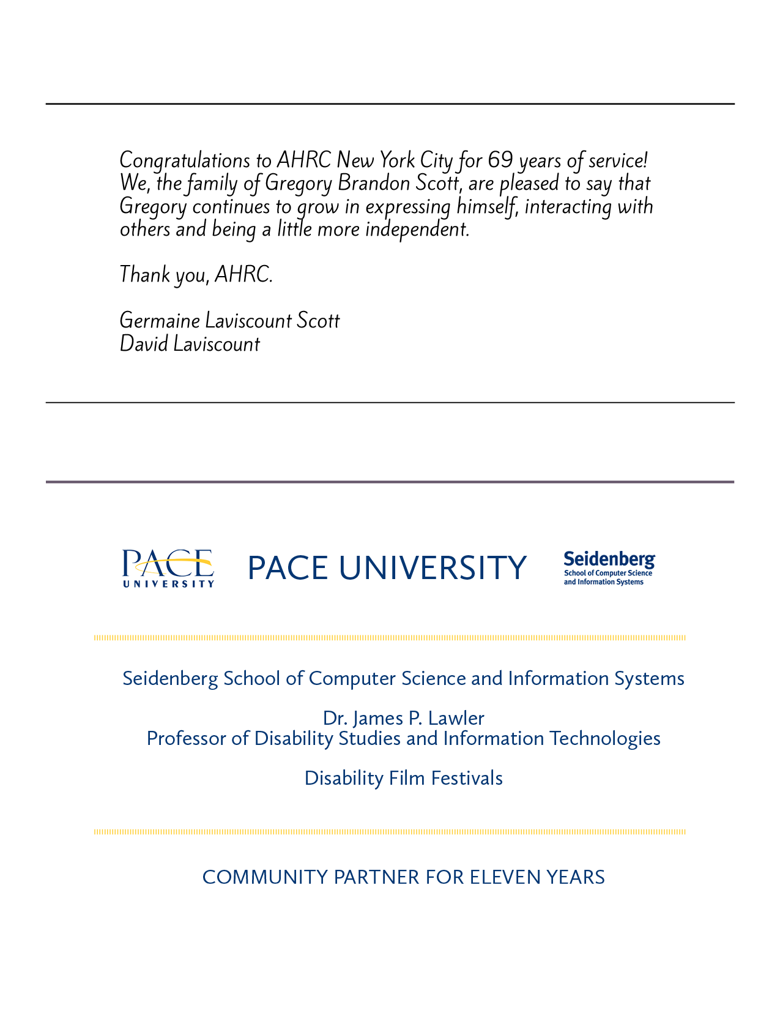
Special
Thanks
To Our
Half Page
Level
Supporters

Slide 11

Special
Thanks
To Our
Quarter Page Level
Supporters

Slide 12

Special
Thanks
To Our
Quarter Page Level
Supporters

Slide 13
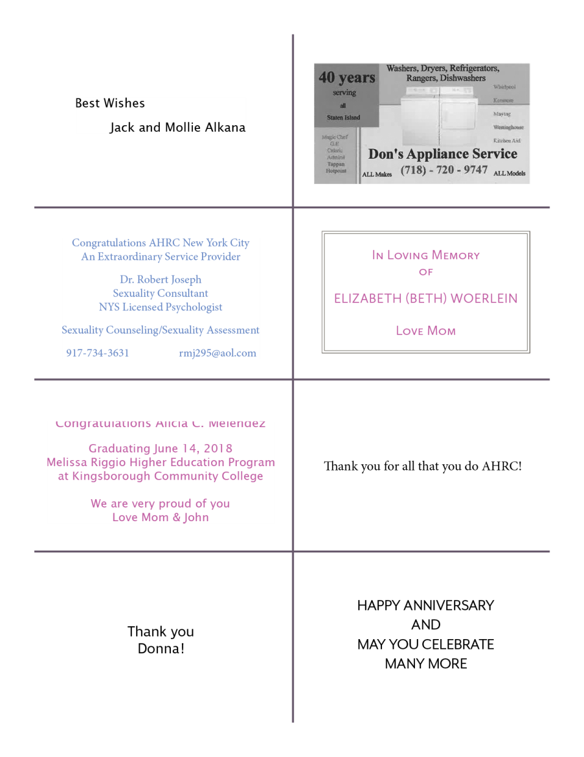
Special
Thanks
To Our
Eighth Page Level
Supporters

Slide 14

Annual Dinner
Generous Donors and Sponsors of AHRC’s Dinner
and the People We Support
4377 Bronx Boulevard Realty, LLC
^{Peter Livoti}
^{Lisa Akker}
^{Lewis Mainzer}
^{Kathy Broderick}
^{Carmen Mojer}
^{Stephen Brodksy}
^{Jose & Maria Ortega}
^{Caris Consulting, LLC.}
^{Lisa Schwebel}
^{Judith DeIasi}
^{Solid Benefit Guidance}
^{Gotham Maintenance}
^{Gina R. Fredericks-Swensen}
^{Caroline Gubitosi}
^{Ruth Toplitsky}
David J. Klein - International Blind Contractors, Ltd.
^{Esme Usdan}
^{Kokeb Kebede}
^{Susan W. Williams}

Slide 15

Thank you
from

